Slide 1
“I’m more excited about ChatOps than any other idea in the last 10 years” – Guido P.
Notes:
Excited because ChatOps is transformative.

Slide 2
change a·gent /CHānjˈājənt/ noun A person who helps an organization transform itself by focusing on such matters as organizational effectiveness, improvement, and development..

Slide 3
chat·ops /Chat äps/ noun A collaboration model that connects people, tools, process, and automation into a transparent workflow.

Slide 4
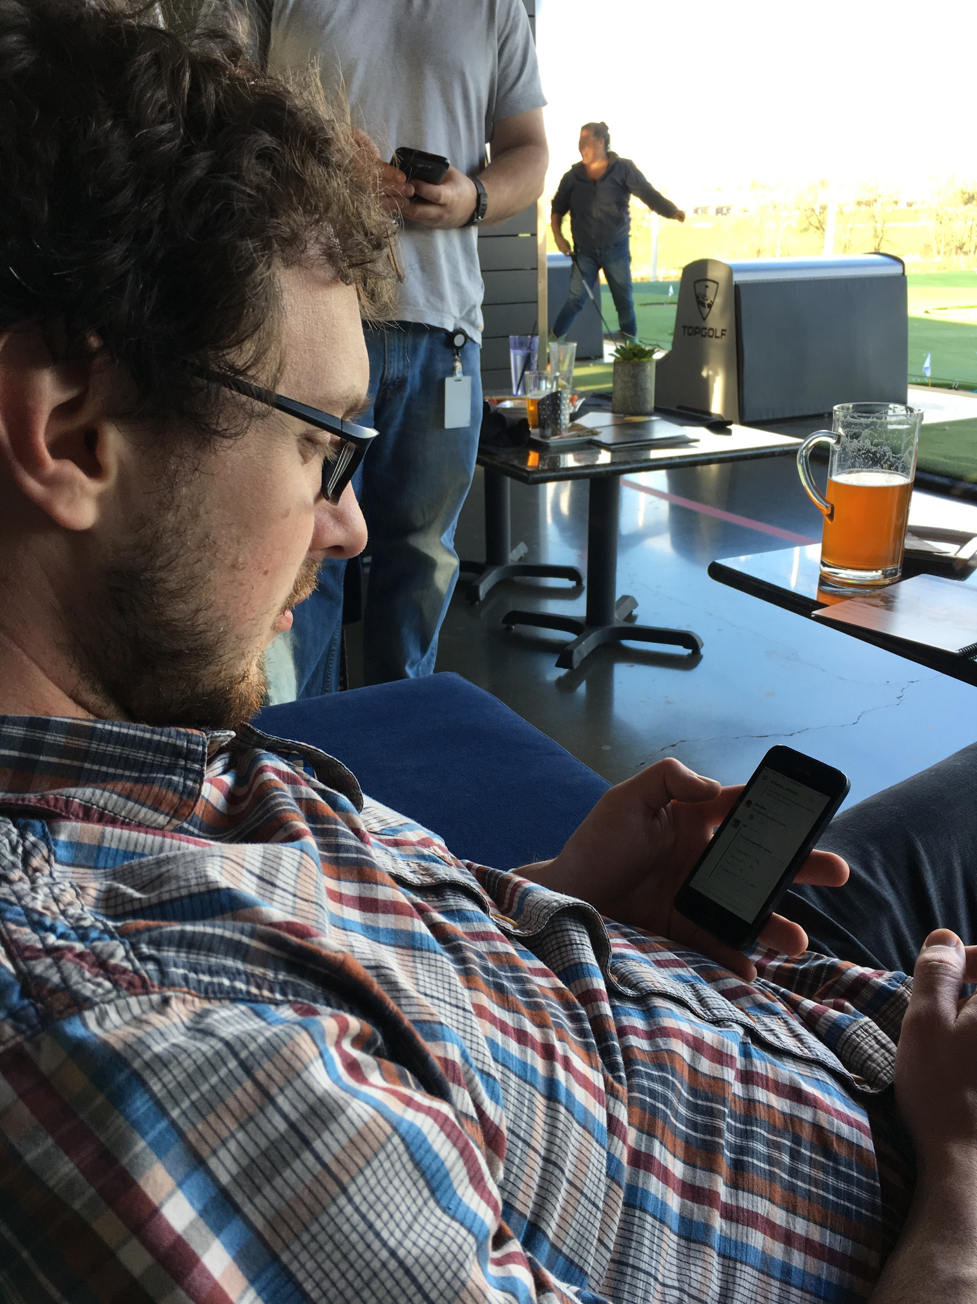
Storage migration in progress with ChatOps monitoring
chat·ops
Notes:
ChatOps enables engineers to spend more time up front automating/testing and all members of the team can then monitor

Slide 5
on·board·ing /änˈbôrdiNG/ noun the action or process of integrating a new employee into an organization or familiarizing a new customer or client with one's products or services.

Slide 6
… New hire day 1
on·board·ing

Slide 7
… Immediate gratification
on·board·ing

Slide 8
… Autobuild Coffee Scripts
on·board·ing

Slide 9
… git, CI pipeline, Hubot
on·board·ing

Slide 10
fric·tion /frikSH(ə)n/ noun conflict or animosity caused by a clash of wills, temperaments, or opinions.

Slide 11
… permissions
fric·tion

Slide 12
… dependencies
fric·tion

Slide 13
… training & experience
fric·tion

Slide 14
… context
fric·tion

Slide 15
… timezone & language
fric·tion

Slide 16
… organization structure
fric·tion

Slide 17
… tribal knowledge
fric·tion

Slide 18
… transparency
fric·tion

Slide 19
… guardrails
fric·tion

Slide 20
… adhoc collaboration
fric·tion

